Slide 1

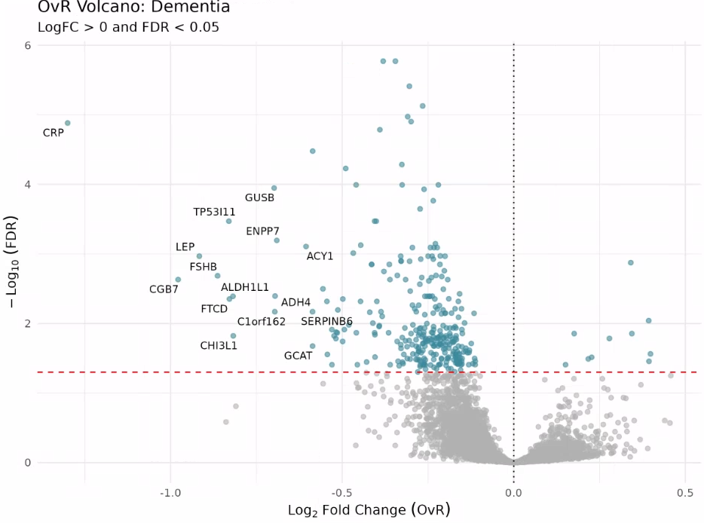
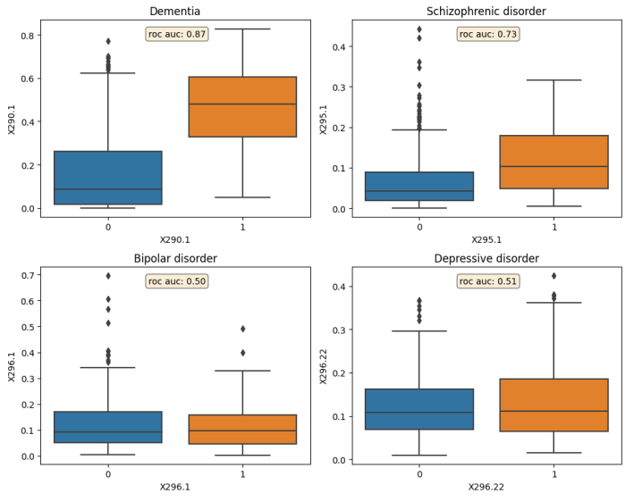
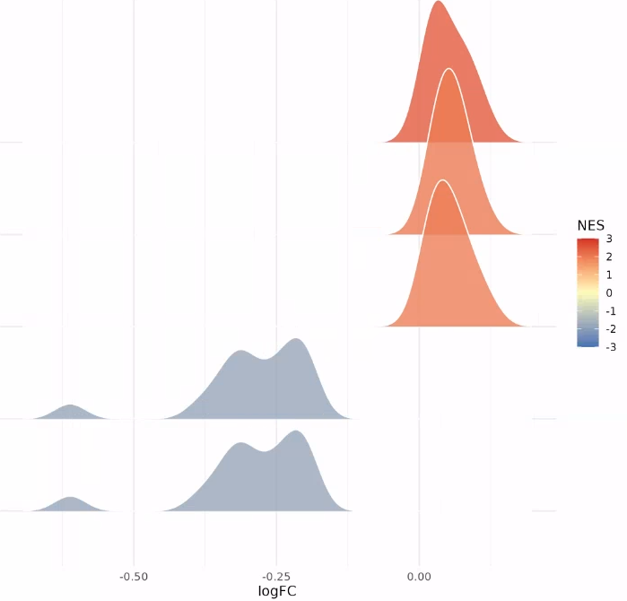
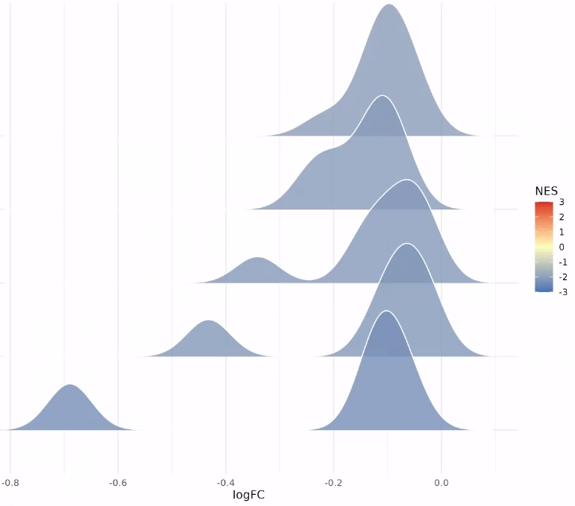
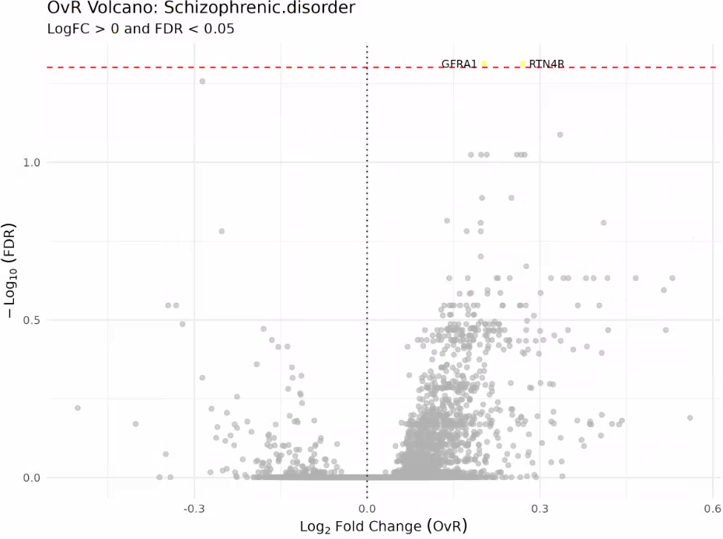
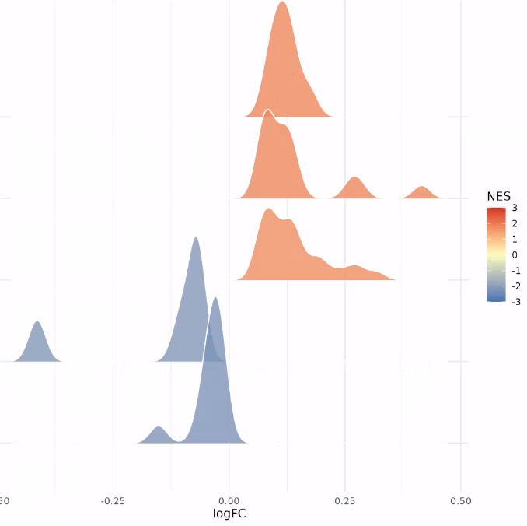
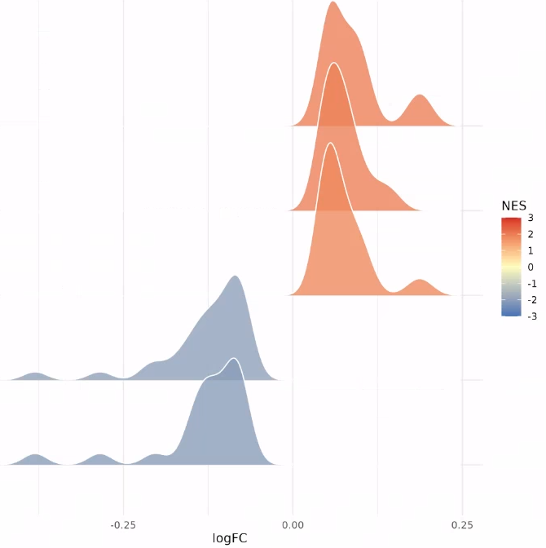

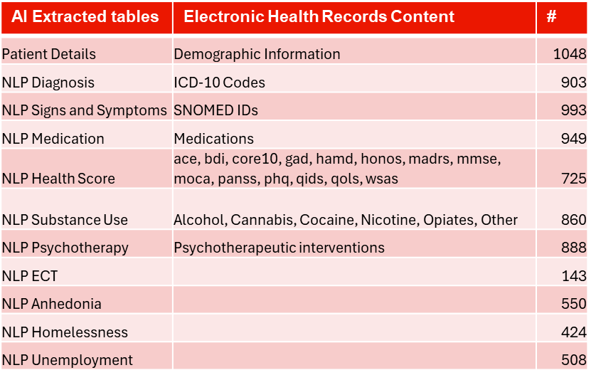
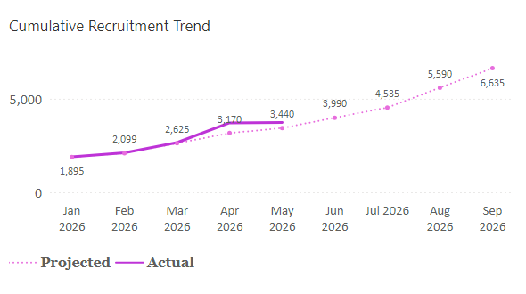
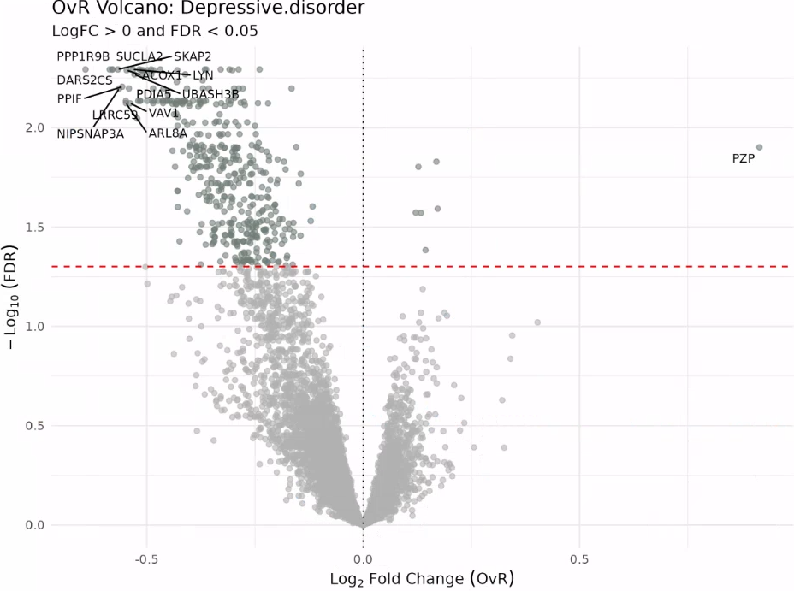
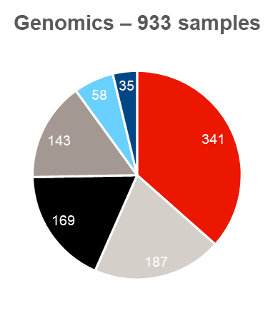
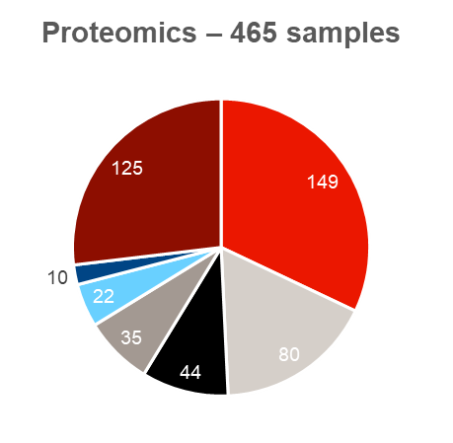
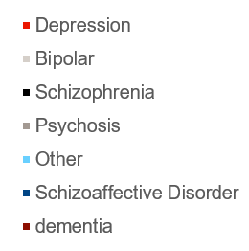
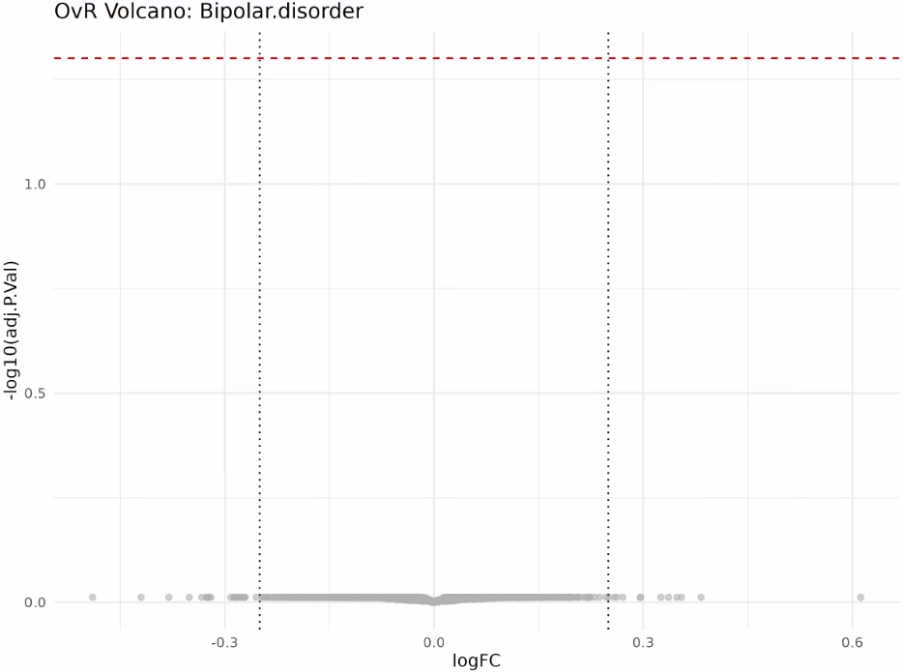
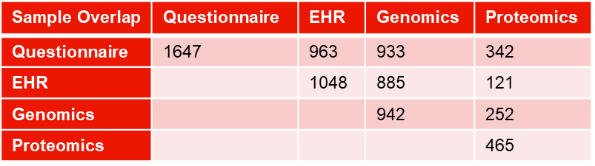
23
Cross-diagnostic proteomic analyses reveal shared and distinct molecular signals in Neuropsychiatric and Neurodegenerative disorders
Joe Pick, Tina Wang, Jie Lisa Ji, Farzad Vasheghani Farahani, Ricardo Harripaul, Erin Smith, Bart Smets, Ardigen, Rancho Biosciences, Dermot Reilly, Gayle Wittenberg, Simon Lovestone, Martin Bringmann
GLOBAL DISCOVERY MEETING
2026
Neuroscience TA
Introduction
Proteomic analyses reveal partial separation of diagnoses
Shared pathway dysregulation across different NP disorders
Global Minds is an actively growing, cross‑diagnostic cohort comprised of EHRs, questionnaires, genomics, and proteomics across several hundred individuals assembled by J&J, Akrivia Health and Wellcome Trust.
Diagnoses include dementia, bipolar disorder, psychosis, major depressive disorder (MDD), and schizophrenia.
To explore whether we could use proteomics to distinguish between these disorders, three complementary approaches were applied :
Differential proteomic abundance
Multi‑task learning models
Proteomic pathway analysis
Multi-task learning (MTL) model
Pathway Analysis
Differential abundance (DA)
Depressive Disorder
Psychosis
Cytolysis by host of symbiont cells
Regulation of Fibrinolysis
Regulation of PSD assembly
Oxygen transport
Dementia
Regulation of Fibrinolysis
Epoxygenase P450 pathway
tRNA aminoacylation for protein translation
Phospholipid efflux
tRNA aminoacylation
Amide catabolic process
Schizophrenia
Bipolar disorder
Composition of Global Minds dataset
Schizophrenia
Branched-chain amino acid catabolic process
Spliceosomal complex assembly
Keratinization
Positive regulation of telomere maintenance
Diterpenoid metabolic process
Protein-RNA complex assembly
Natural killer cell degranulation
Myofibril assembly
Pentose-phosphate shunt
Sarcomere organization
Color Key
Protein Synthesis
Inflammation Processes
Metabolic Pathways
Structural Organization
Synapse signaling
Cell Cycle
Depression
GSEA ridgeplots illustrate similar pathways are altered across different neuropsychiatric disorders highlighting the subtleties and complexities in these diseases
Conclusions and Next Steps
No single analytical approach uniformly separates disorders, highlighting methodological complementarity rather than redundancy.
Dementia shows robust, cross-method proteomic differentiation, whereas bipolar disorder lacks detectable signal across approaches.
Schizophrenia and depression exhibit method-specific signals, suggesting distinct analytical frameworks capture different dimensions of disease biology
Pathway analysis reveals shared biological processes perturbed across disorders, with differences primarily in magnitude rather than identity.
Next Steps:
Which proteins drive the MTL signature for schizophrenia?
Can unbiased proteomic clustering reveal subtypes of diseases or common cross-diagnostic proteomics?
Bipolar
Differential protein abundance was assessed using limma (Linear Models for Microarray Data) with one-vs-rest contrasts, identifying primarily downregulated proteins in dementia and depressive disorders, but not schizophrenia or bipolar disorder.
MTL trained on 444 diseases using Olink proteomics from UKB and transformed to SomaScan can distinguish dementia and schizophrenia from the others, but fails when evaluating depression and bipolar disorder.
Confidential Information – Proprietary to Johnson & Johnson

